Slide 1
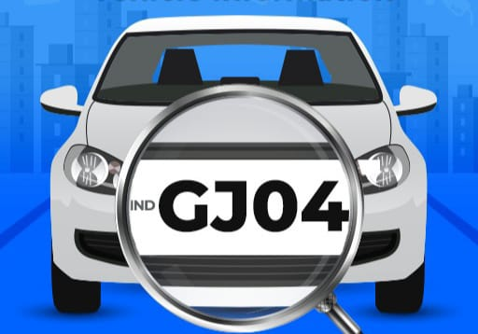
Parking Assistance App
Look Up and Scan Number Plates and get Vehicle Owner details in second

Slide 2
TABLE OF CONTENTS
03.
Tech
Stack
01.
Problem Statement
02.
Problem
Solution
04.
Scope of
Application
05.
App Interface &
Results
06.
Challenges

Slide 3

DOES YOUR VEHICLE ALSO
GET STUCK
DUE TO IRREGULAR PARKING ?

Slide 4

Ever Faced a Problem Connecting with
Vehicle Owners in Emergency ?

Slide 5
PROBLEM STATEMENT
The shortage of space results in people parking their vehicles almost anywhere without organization. Usually what happens is that in unorganized spaces, people park their vehicles behind other already parked vehicles and this many times leads to chaos when the vehicle parked in the interior needs to get out of there as some vehicle is always blocking the exit. There needs to be a medium to contact the driver of the the vehicle blocking the exit so that the stuck vehicle owner can ask them to move their vehicle a bit so that they can bring out theirs.
We can use this system for automatic data management of vehicles in a parking, we can sell it to organized parking places like shopping malls, offices, colleges and what not.

Slide 6



A Parking Assistance App, one touch and you can contact any Vehicle Owner directly

Slide 7
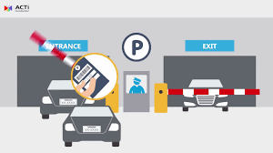
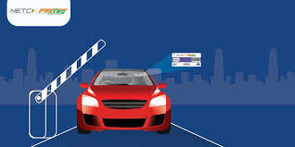
SCOPE OF THE APPLICATION
PARKING MANAGEMENT
CHALLAN’S
VEHICLE DATABASE
EASE OF TRANSACTION AT TOLL-BOOTHS

Slide 8
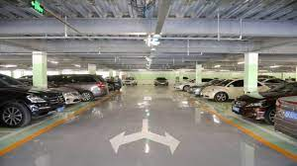
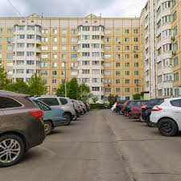
SCOPE OF THE APPLICATION
USEFUL FOR PARKING MANAGEMENT IN SHOPPING COMPLEXES , SOCIETIES , COLLEGES ,
TOURIST PLACES AND SHOPPING MALLS etc.

Slide 9





Tech Stack
PYTHON
DJANGO
SPRING BOOT
MYSQL
ANDROID

Slide 10
APP INTERFACE
&
RESULTS

Slide 11
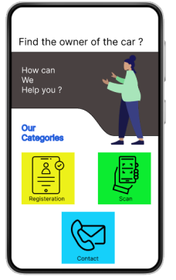
APP OVERVIEW
REGISTER
SCAN
People using parking facility are registered first
Scanning and uploading of number plate image
CONTACT
Option to Send Message / Call Vehicle owner

Slide 12
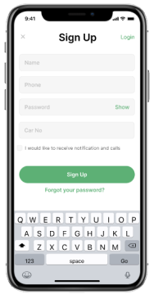
SIGN UP

Slide 13
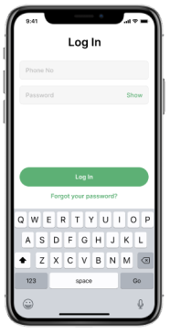
LOG IN

Slide 14
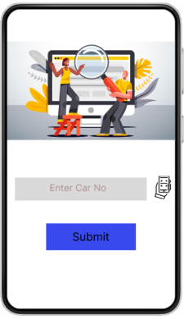
SEARCH FOR A VEHICLE OWNER

Slide 15
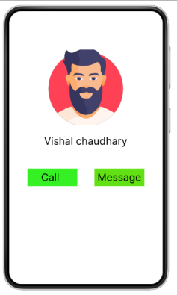
USER CONTACT
DETAILS

Slide 16
OPTICAL CHARACTER RECOGNITION
Optical Character Recognition (OCR) is the process that converts an image of text into a machine-readable text format.

Slide 17
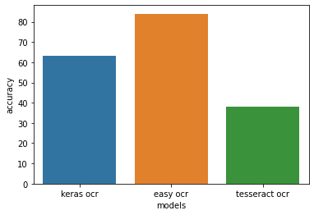
Best Available Models for OCR
Keras OCR
Easy OCR
Tesseract OCR
Accuracy (in percentage) comparison of different OCR models available in Python

Slide 18
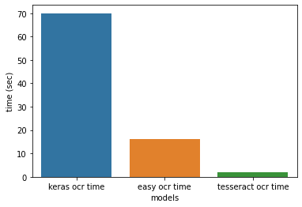
Execution Time for Different OCR Models
Keras OCR
Easy OCR
Tesseract OCR
time (in seconds) comparison for execution of different OCR models in Python

Slide 19
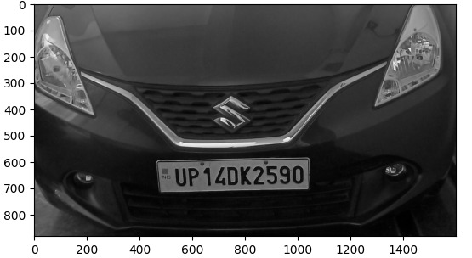
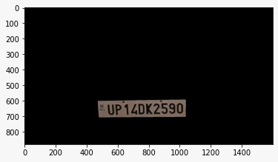
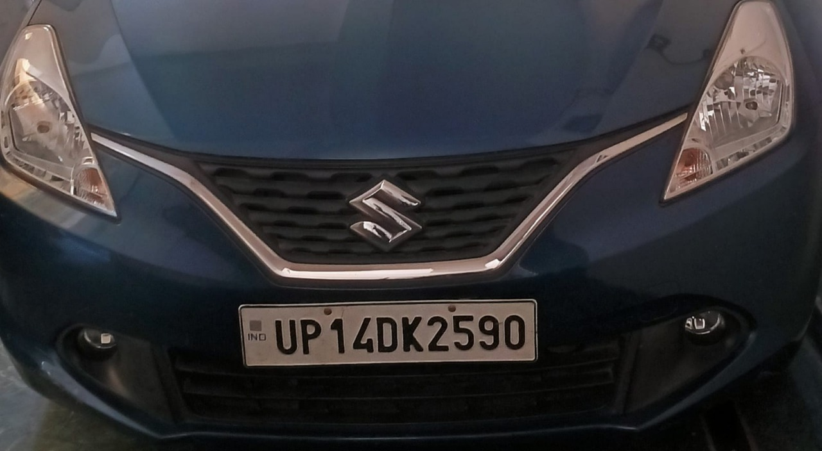
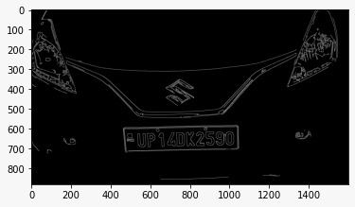
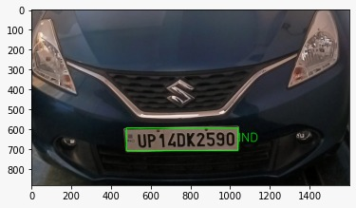
Procedure for detecting and extracting number plate
Input the image
Convert the image to gray scale
Defining contours and finding them
Cropping the image on the basis of contours
OCR identifies the characters in the region

Slide 20
CHALLENGES
Getting good precision and accuracy from model
ANPR MODEL
To integrate api with our model and application
API
CAMERAS
Better quality cameras

Slide 21
OUR TEAM
Shourya Nagpal
Vishal Singh Chaudhary
Yash Kumar
1900320100154
1900320100199
1900320100202
Computer Science & Engineering
Batch - 2019-2023
Abes Engineering College

Slide 22

THANKS
Do you have any questions?
Team Name -
Mentors Name -

